Slide 1
Push Up

Slide 2
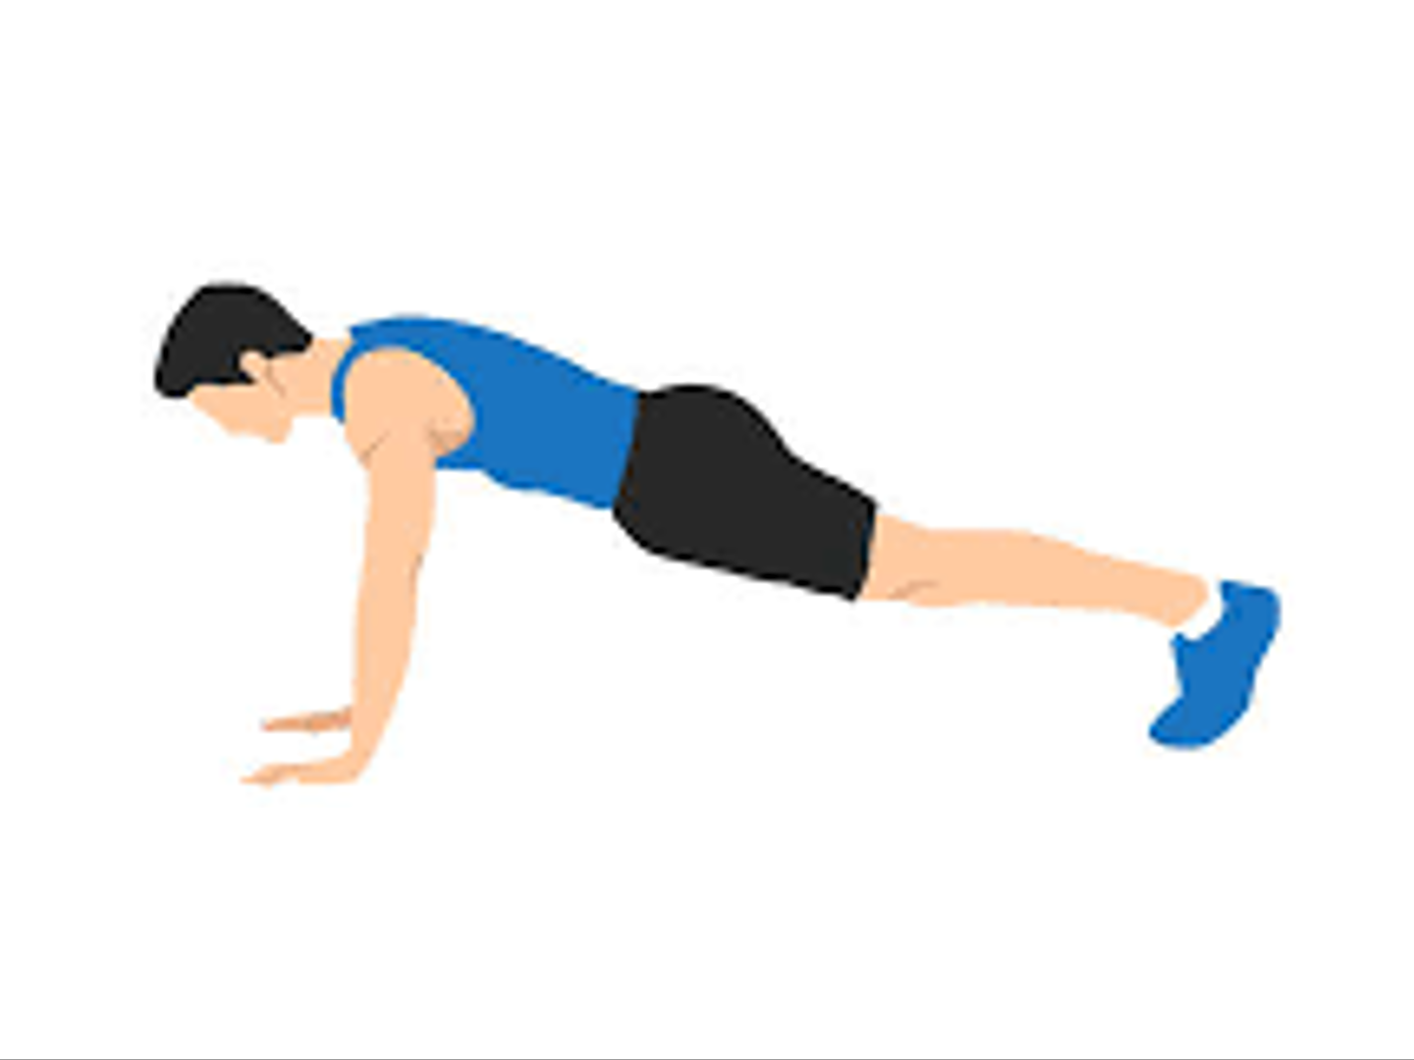

Slide 3
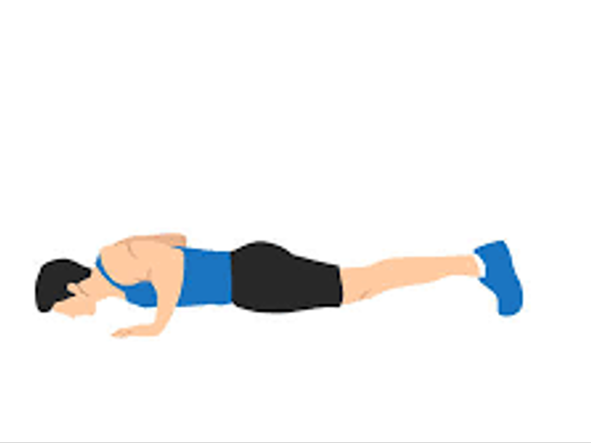

Slide 5
Curl Up

Slide 6
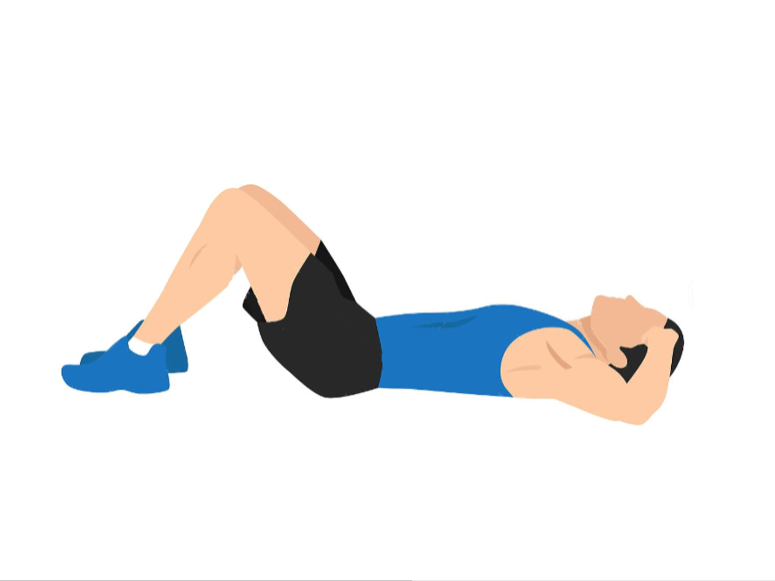

Slide 7
